Slide 1
CAMPUS LOST & FOUND MANAGEMENT SYSTEM
LostLink
An Oracle PL/SQL powered backend for reporting, smart matching, and secure claim processing of lost and found items on campus.
Database Engine • Oracle 11g XE Backend • PL/SQL Web • PHP 8 (OCI8)

Slide 2
PROJECT OVERVIEW
What LostLink Does
LostLink manages the backend operations for a centralized campus lost and found platform. It handles user authentication, item reporting, smart matching, secure claim processing, and real-time notifications.
Strict transaction management maintains data integrity and prevents false claims, while the design facilitates connections between finders and losers with an auditable log of every activity.
8
Core database tables
10+
Stored procedures
12
Analytics & retrieval functions
4
Automated triggers
LostLink | 02

Slide 3
TECH STACK
Tools & Technologies
1
Database Engine
2
Query Language
Oracle Database 11g Express Edition (XE)
SQL and PL/SQL
3
Web Application
4
Web Server
PHP 8 with OCI8 Extension, HTML, CSS, JavaScript
Apache (XAMPP)
LostLink | 03

Slide 4
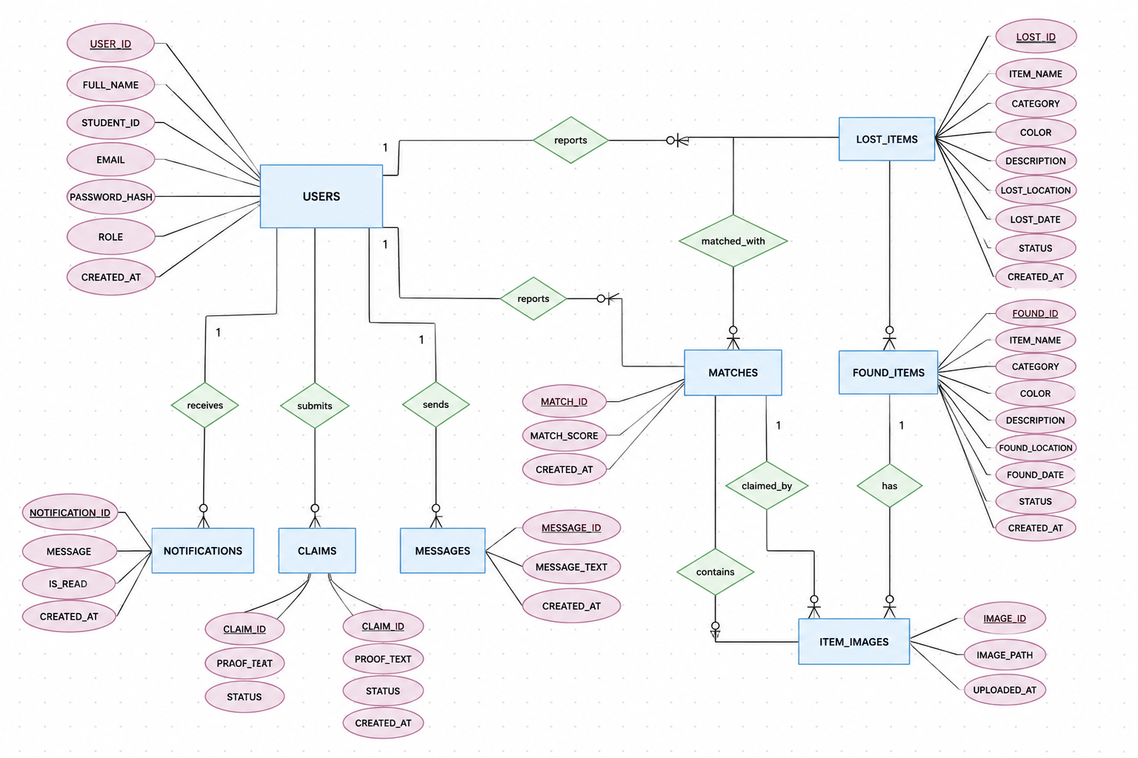
DATABASE DESIGN
Entity Relationship Diagram
LostLink | 04

Slide 5
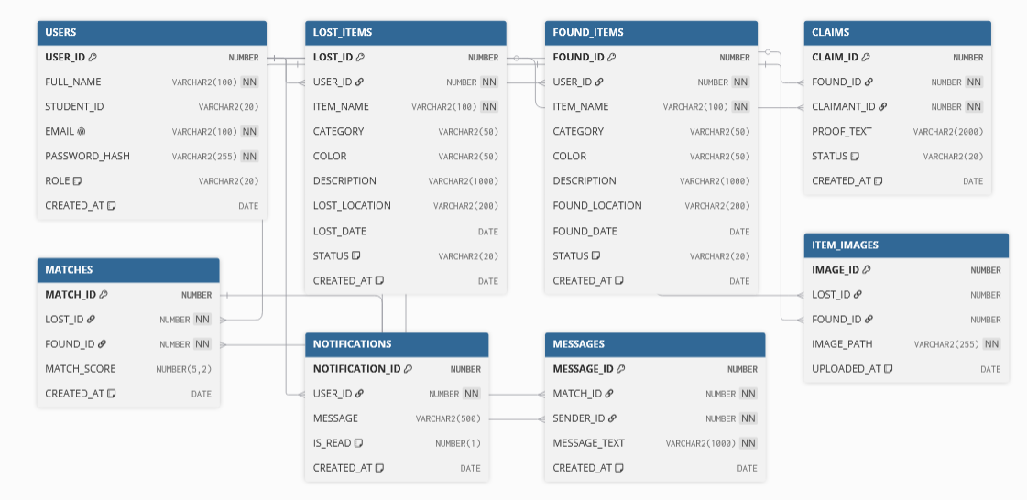
DATABASE DESIGN
Relational Schema Diagram
Physical tables, primary keys, and foreign key dependencies implemented in the database.
LostLink | 05

Slide 6
DATABASE DESIGN
Core Database Tables
USERS
Central authentication & role management (Admin vs User)
LOST_ITEMS
Records of items reported lost, linked to reporting user
FOUND_ITEMS
Found item records; status defaults to UNCLAIMED
ITEM_IMAGES
Stores file paths for uploaded lost/found item photos
MATCHES
Pairings between lost & found items with a match score
CLAIMS
Secure ledger for ownership claims; status PENDING by default
NOTIFICATIONS
System-generated alerts for matches & claim updates
MESSAGES
Chat between users connected via a smart match
LostLink | 06

Slide 7
DATABASE DESIGN
Table Relationships
One-to-Many
Many-to-Many
USERS maintains a one-to-many relationship with LOST_ITEMS, FOUND_ITEMS, CLAIMS, NOTIFICATIONS, and MESSAGES.
A single user can report multiple items or send multiple messages, but each item or message belongs to only one user.
LOST_ITEMS and FOUND_ITEMS relate many-to-many: one lost item can potentially match multiple found items, and vice versa.
This is resolved with the MATCHES table acting as an intersection entity connecting LOST_ID and FOUND_ID.
LostLink | 07

Slide 8
BACKEND LOGIC
Stored Procedures
Encapsulate business logic to ensure secure, atomic database operations.
SP_REGISTER_USER
SP_REPORT_LOST_ITEM / SP_REPORT_FOUND_ITEM
Securely inserts new user records with name, student ID, email, and password hash.
Inserts item details and returns the new LOST_ID/FOUND_ID for image upload.
SP_FILE_CLAIM
SP_PROCESS_CLAIM
Creates a new ownership claim with PENDING status and proof of ownership.
Admin approval/rejection; cascades status updates to RECOVERED on approval.
SP_UPDATE_LOST_ITEM / SP_DELETE_LOST_ITEM
SP_UPDATE_USER_PROFILE
Lets users update or securely delete their reported items.
Updates a user's full name and student ID.
SP_ADD_MESSAGE
SP_ADD_ITEM_IMAGE
Securely inserts real-time chat messages between matched users.
Links an uploaded image path to a LOST_ID or FOUND_ID.
LostLink | 08

Slide 9
BACKEND LOGIC
Functions
Used for data retrieval, analytics, and complex calculations — most return a SYS_REFCURSOR for the PHP frontend.
FN_GET_USER_BY_EMAIL
FN_CALCULATE_MATCH_SCORE
Authentication lookup during login.
Core smart-matching algorithm; scores category, color, and date similarity.
FN_GET_USER_CLAIMS / FN_GET_PENDING_CLAIMS
FN_GET_USER_NOTIFICATIONS
Retrieves a user's claims, or all claims pending admin review.
Fetches unread and historical notifications.
FN_GET_MESSAGES
FN_GET_ITEM_IMAGE
Retrieves chronological chat history for a match.
Returns the file path of an item's primary image.
FN_GET_USER_PROFILE
FN_GET_OVERALL_STATS / CATEGORY / HOTSPOT / RECENT_ACTIVITY
Retrieves profile display information.
Dashboard analytics: totals, category breakdowns, hotspots, recent actions.
LostLink | 09

Slide 10
BACKEND LOGIC
Triggers & Automation
Auto-Increment Triggers
1
Oracle 11g lacks native AUTO_INCREMENT — BEFORE INSERT triggers fetch NEXTVAL from sequences (USERS_BI, LOST_ITEMS_BI, FOUND_ITEMS_BI) to assign primary keys.
TRG_MATCH_ON_LOST_INSERT
2
Fires after a new lost item is reported — scans UNCLAIMED found items, scores matches, and populates the MATCHES table.
TRG_MATCH_ON_FOUND_INSERT
3
Fires after a new found item is reported — scans ACTIVE lost items and proactively alerts users of a possible match.
LostLink | 10

Slide 11
SYSTEM WORKFLOW
How LostLink Works — 4 Phases
PHASE 1
PHASE 2
PHASE 3
PHASE 4
Registration & Reporting
Smart Matching & Chat
Claims & Verification
Analytics & Reporting
Users register with Name, Student ID & Email; report lost/found items with category, location, date, and images.
The system scores potential matches, creates MATCHES records, sends notifications, and enables secure chat.
Users file claims with proof of ownership; admins review and approve/reject, updating item status to Recovered.
Dynamic dashboards show Total Lost, Found, Recovered, and Pending Claims — personal for users, global for admins.
LostLink | 11

Slide 12
CAPABILITIES
System Features
User Authentication
Smart Matching System
Real-Time Communication
Secure hashing and role-based access control (Admin vs User).
Automated pairing of lost and found items by category and details.
Integrated chat lets users discuss matches directly.
Search & Filtering
Dynamic Dashboards
Image Management
Real-time JavaScript filtering by category and status.
Context-aware stat cards adapt to the user's role.
Seamless upload and retrieval of item photos for verification.
LostLink | 12

Slide 13
User Interface
Screens experienced by students reporting lost & found items

Slide 14
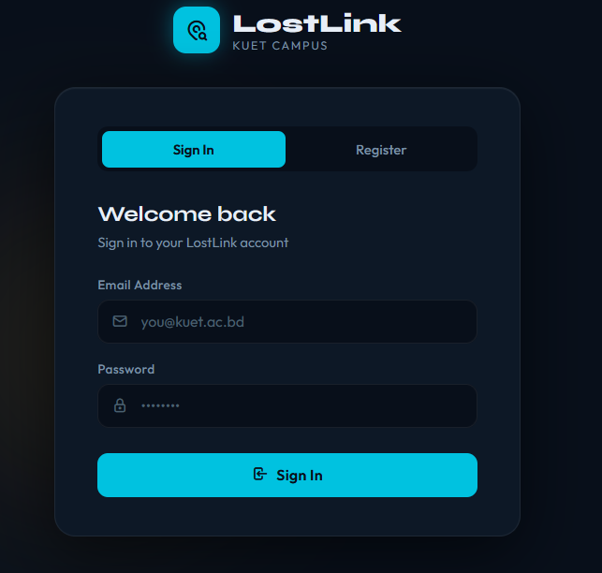
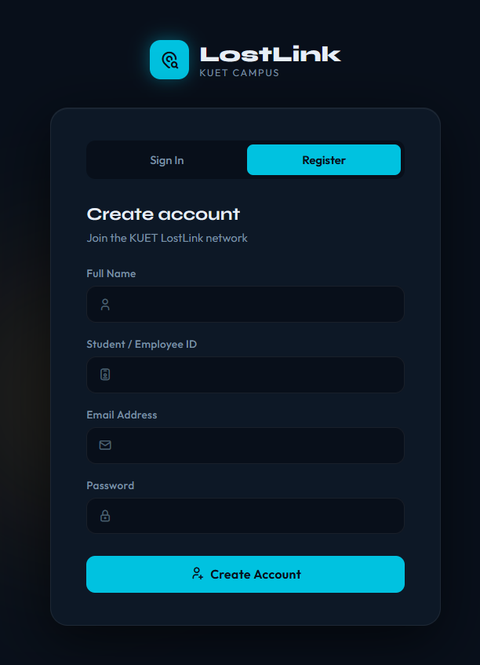
USER INTERFACE
Login & Registration
Login screen
Registration screen
LostLink | 13

Slide 15
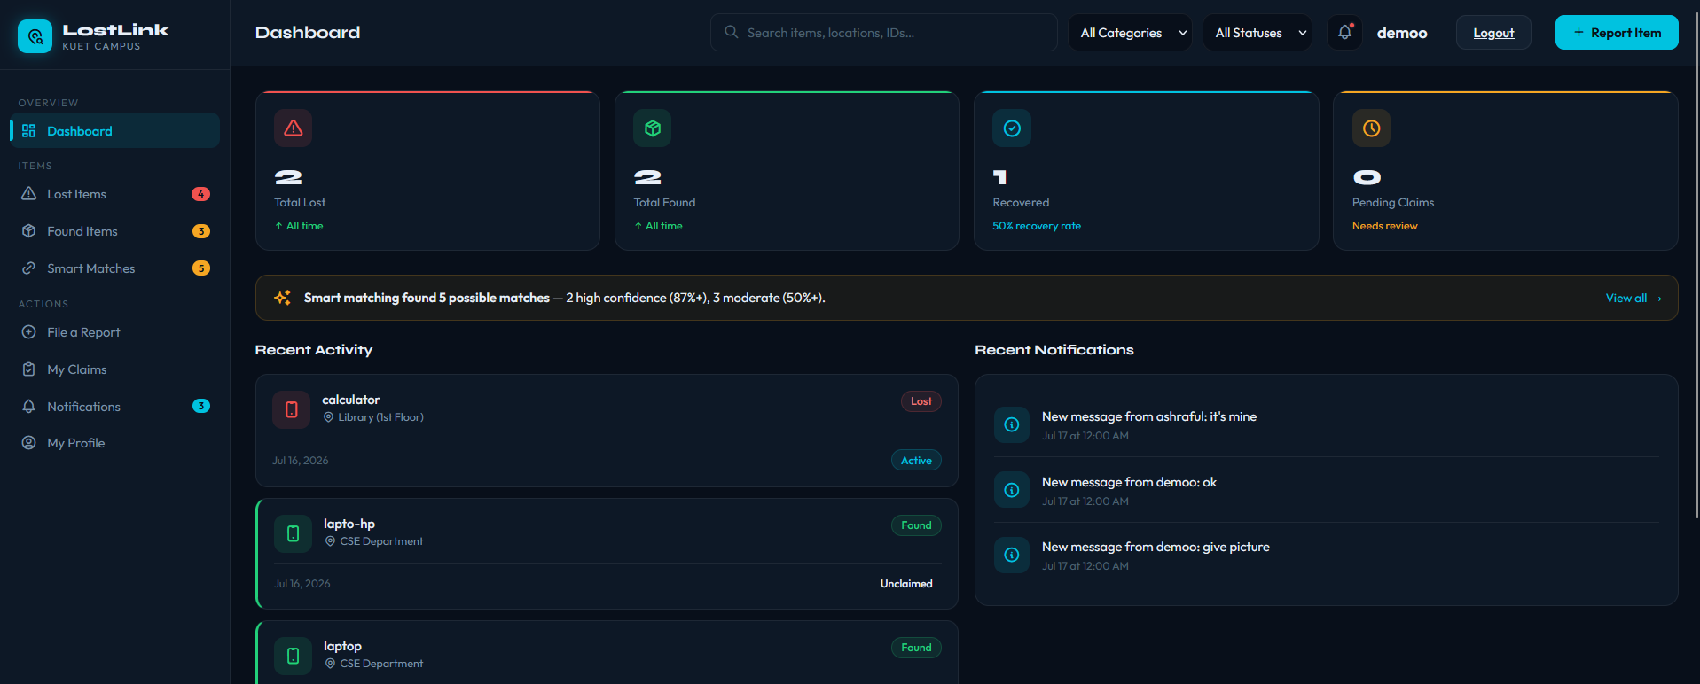
USER INTERFACE
User Dashboard
Personalized overview of a student's reported items and activity.
LostLink | 14

Slide 16
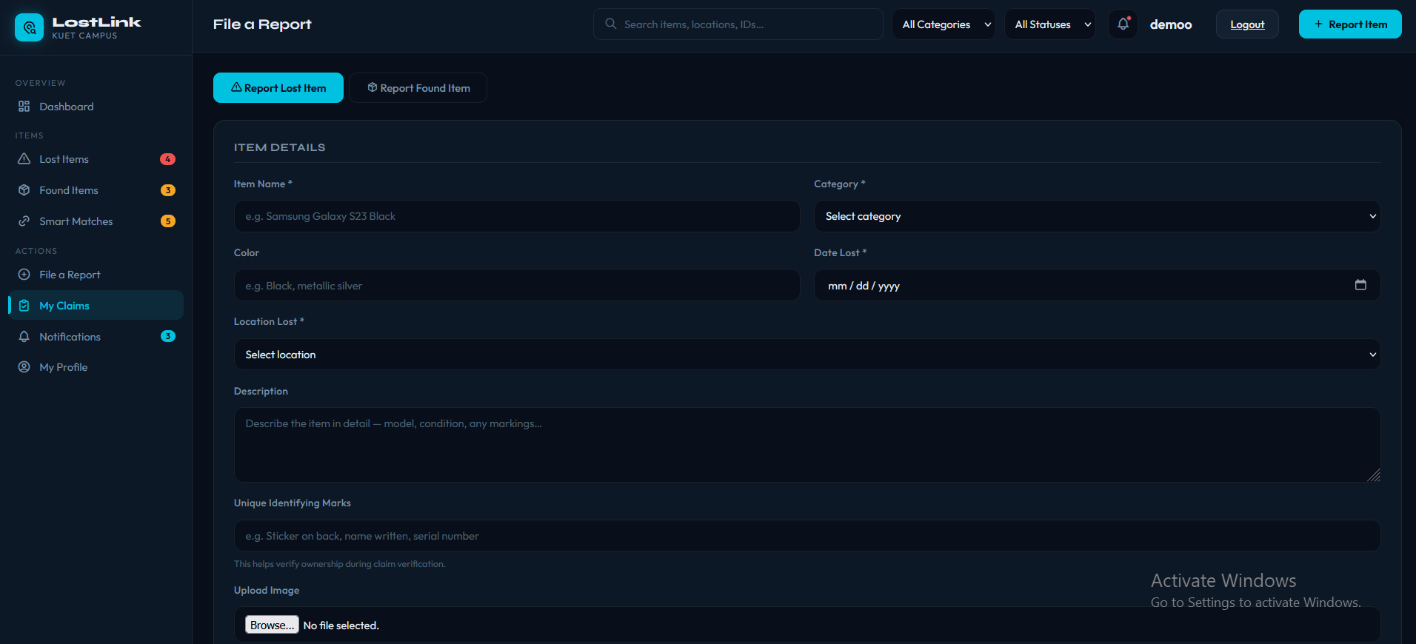
USER INTERFACE
Report a Lost Item
Form for submitting a lost item report with category, location, and date.
LostLink | 15

Slide 17
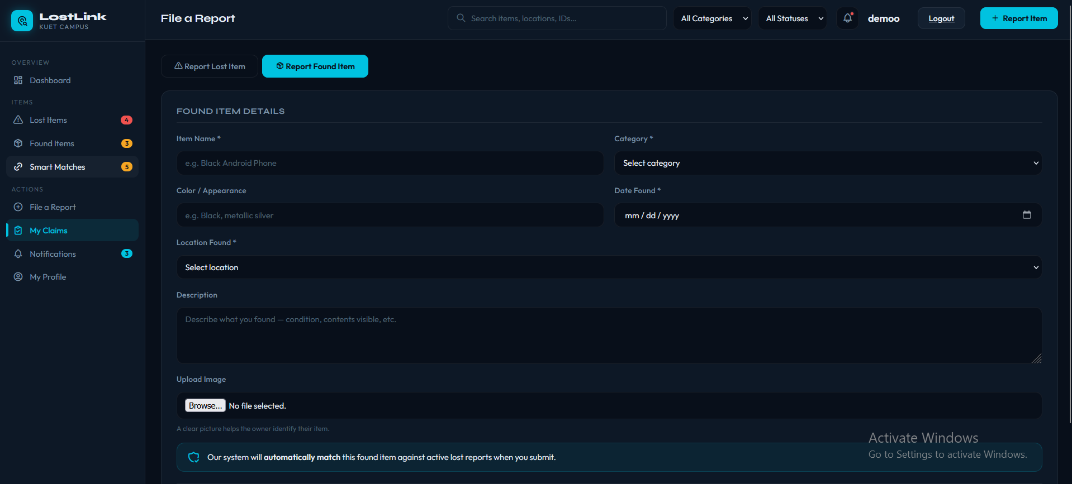
USER INTERFACE
Report a Found Item
Form for submitting a found item report for the campus registry.
LostLink | 16

Slide 18
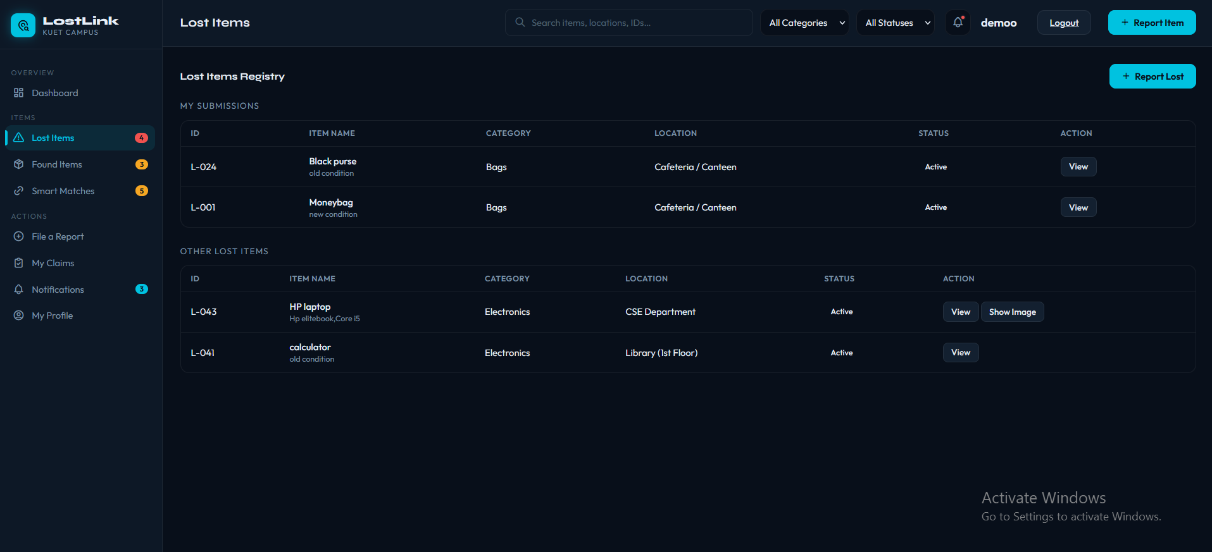
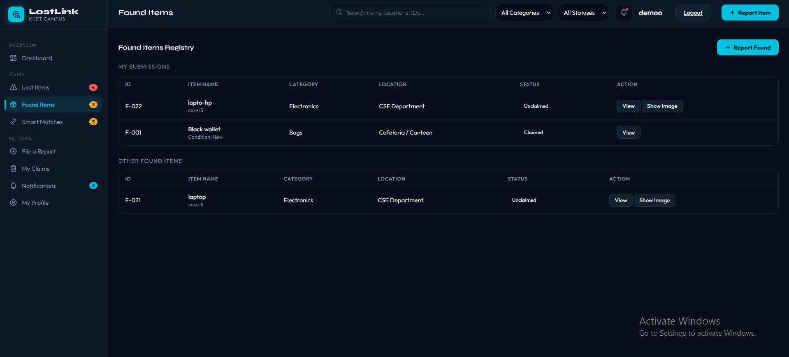
USER INTERFACE
Browse Lost & Found Listings
Real-time search and filtering by category and status.
Lists of Lost & Found items reported by the user
Search items by category and status
LostLink | 17

Slide 19
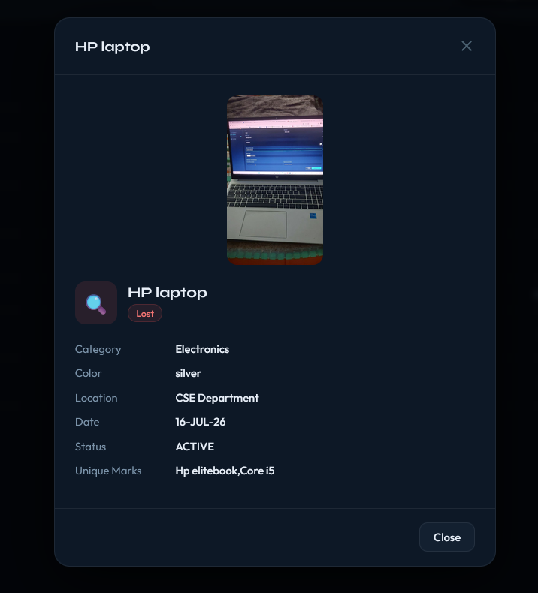
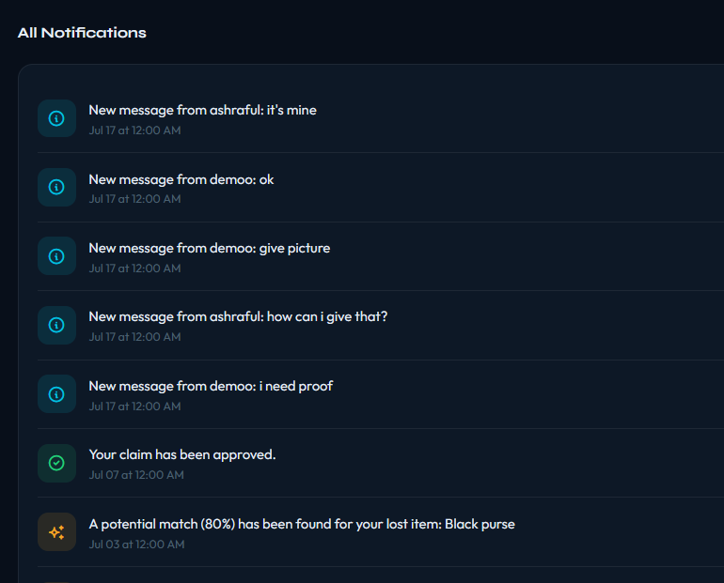
USER INTERFACE
Item Details & Notifications
Item detail view
Notification panel
LostLink | 18

Slide 20
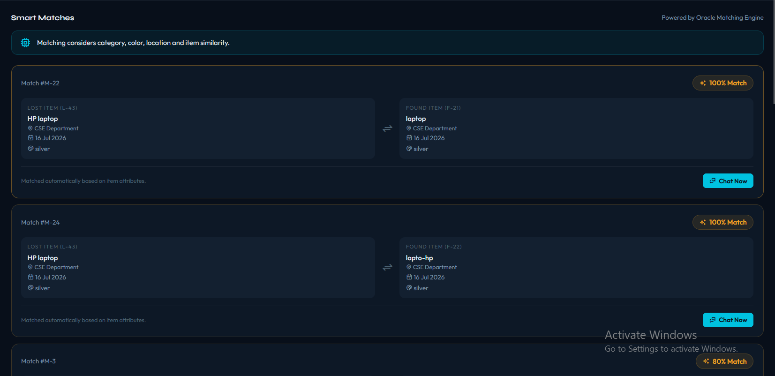
USER INTERFACE
Smart Matches
LostLink | 19

Slide 21
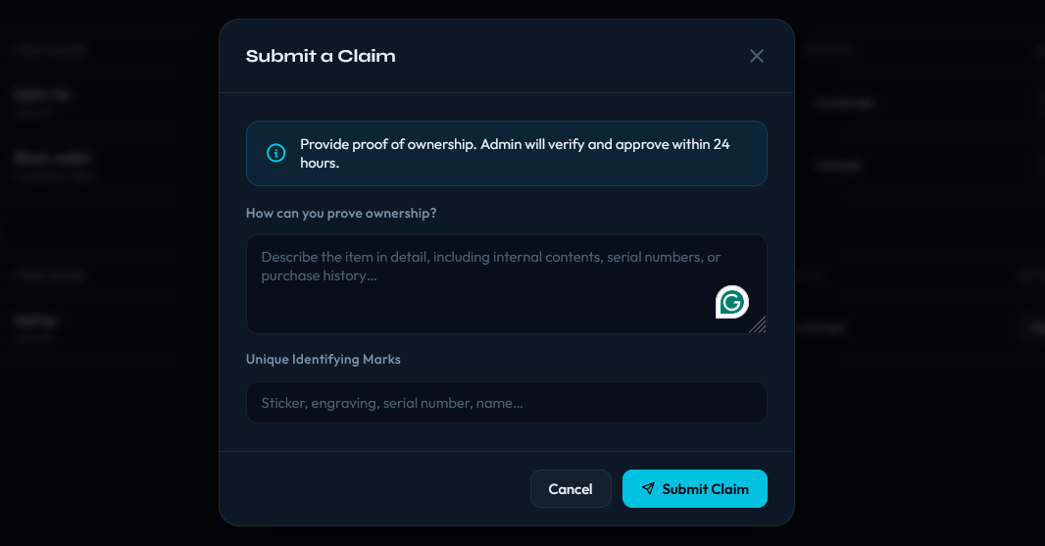
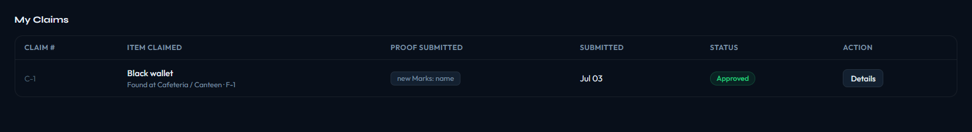
USER INTERFACE
Claims
Submit claim proof
Lists of claim items after submitting claim proof
LostLink | 20

Slide 22
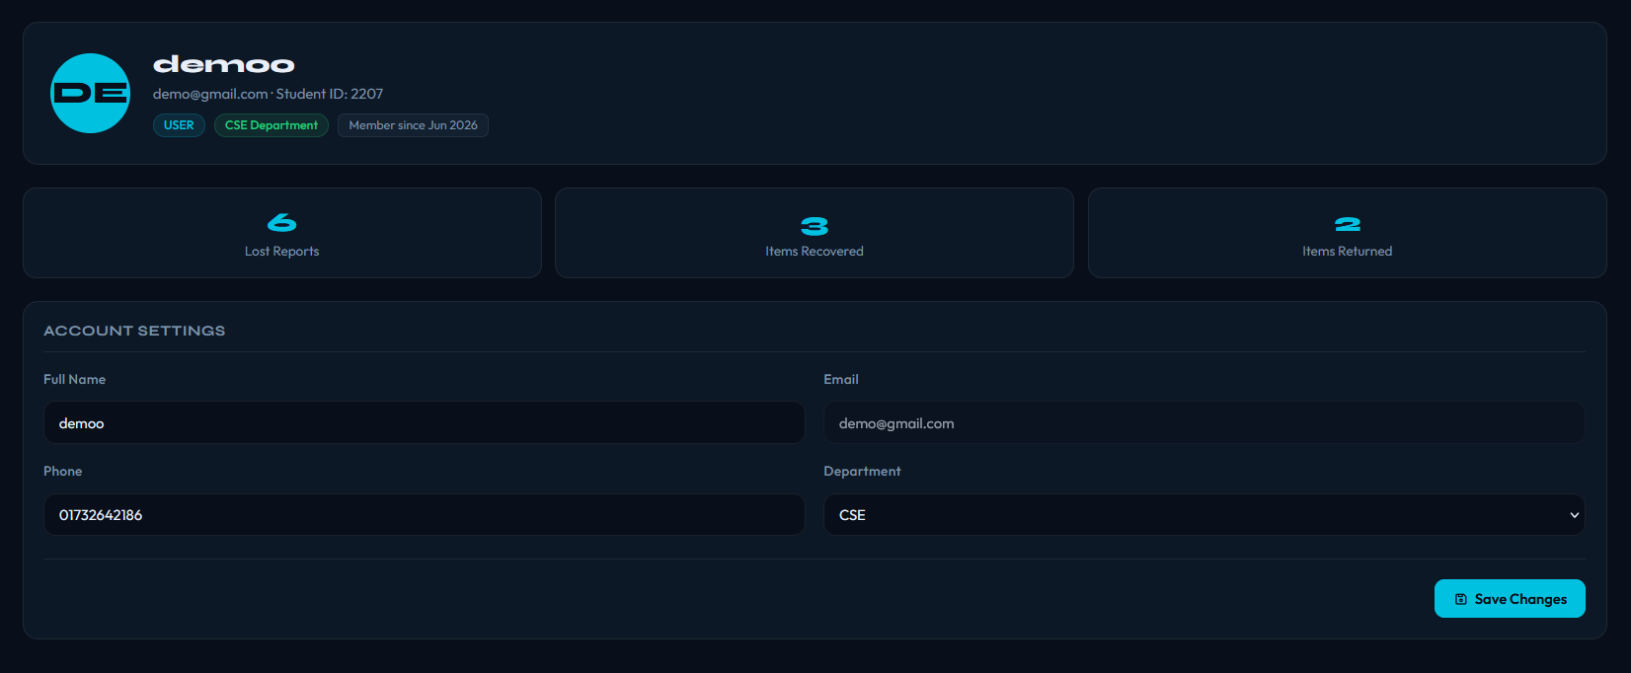
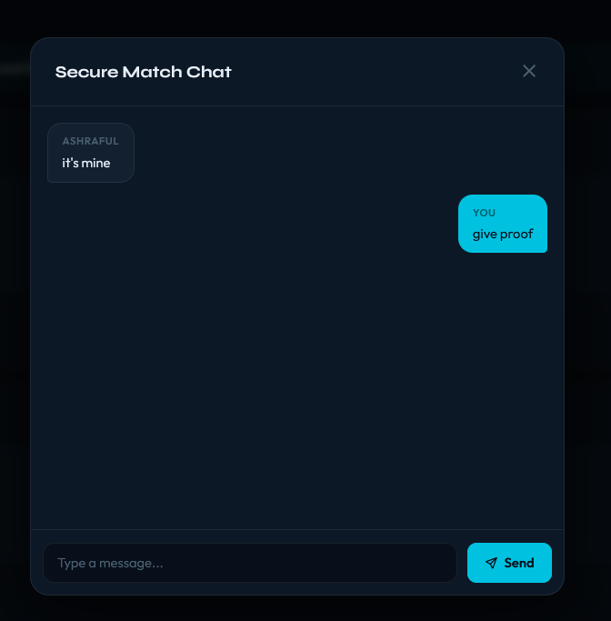
USER INTERFACE
Profile & Real-Time Chat
User profile management
Secure messaging between matched users
LostLink | 21

Slide 23
Admin Interface
Tools for administrators to verify claims and monitor the system

Slide 24
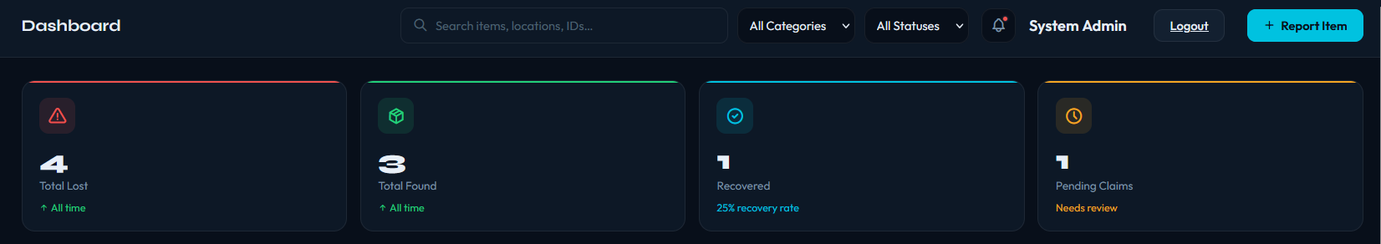
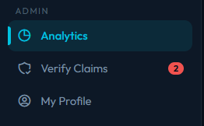
ADMIN INTERFACE
Admin Dashboard
Global, system-wide metrics across all users and items.
LostLink | 22

Slide 25
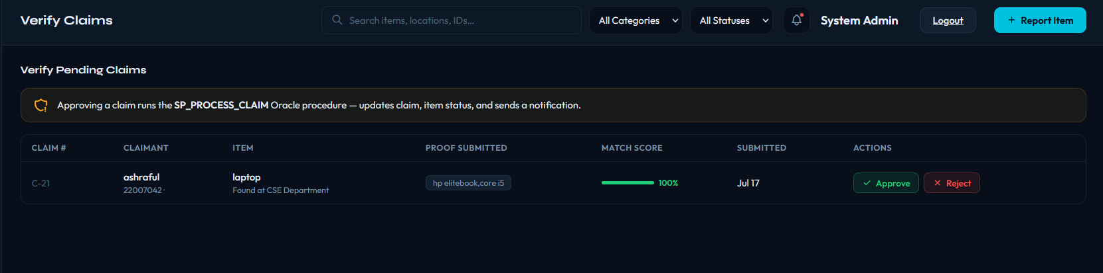
ADMIN INTERFACE
Claims Management
Admins review pending claims and proof of ownership before approving or rejecting.
LostLink | 23

Slide 26
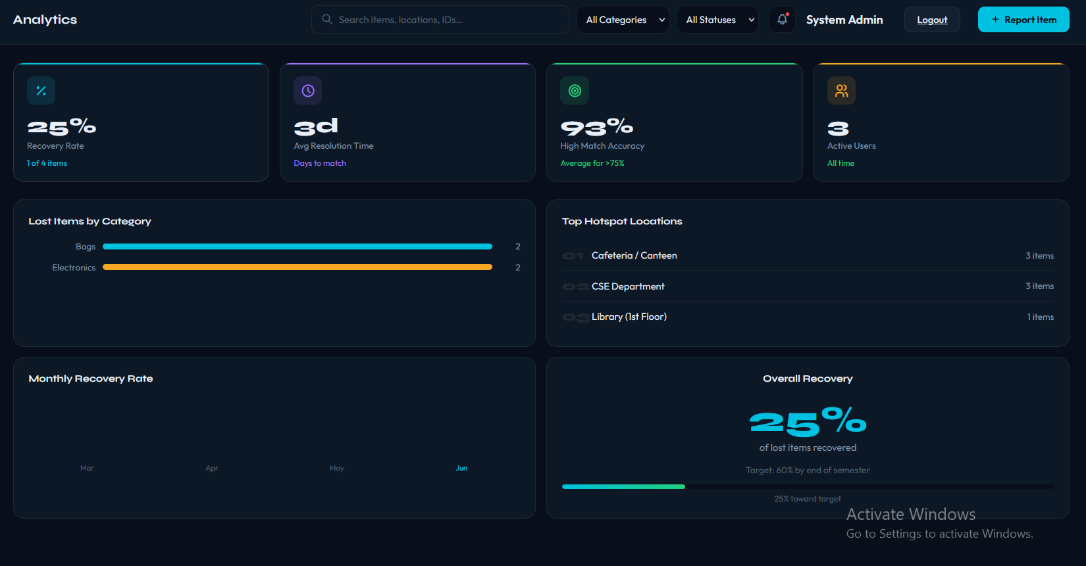
ADMIN INTERFACE
Analytics & Reporting
Aggregate stats: totals by category, hotspot locations, and recent activity.
LostLink | 24

Slide 27
CONCLUSION
A Secure, Auditable Backend
LostLink successfully provides a secure backend for campus lost and found management. By implementing business logic directly inside Oracle using PL/SQL, the system guarantees data consistency through the application interface.
The strict relational design prevents anomalies and redundancy, while robust foreign keys, triggers, and sequences handle complex workflows like smart matching and claim verification efficiently.
Thank you

